Slide 1
CE 3372 Water Systems Design
Lesson 004: PRESSURE PIPE HYDRAULICS

Slide 2
Outline
Hydraulics of Closed Conduits
Pipelines and Networks
Continuity
Energy Equation

Slide 3
Conduit Hydraulics
Hydraulics is an applied science that deals with the mechanical properties of liquids.
fluid mechanics provides the theoretical foundation for hydraulics.
In water systems (this course) the working fluid is usually water (the root of the word hydraulics)
Hydraulics also refers to machinery that use various working fluids

Slide 4
Water characteristics
Water moves from higher to lower energy (along the path of least resistance)
Head is energy per unit weight of a fluid.
Gravity flow – change in elevation provides the required energy
Pressure flow – change in pressure provides the required energy Pumps are used to increase energy to move water to a higher elevation or over a barrier

Slide 5
Water characteristics
Flow of water creates friction/resistance; hence there is loss of energy along a flow pat
Flow rate is related to cross sectional flow area and mean section velocity

Slide 6
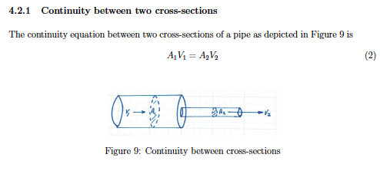
CONTINUNITY AT DIFFERENT SECTIONS

Slide 7
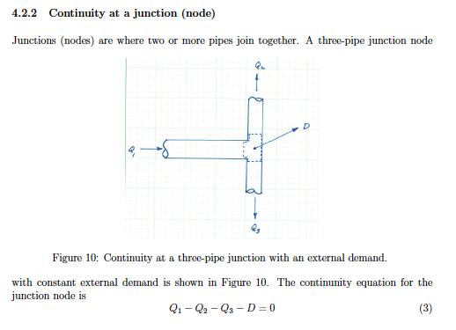
CONTINUNITY AT A JUNCTION

Slide 8
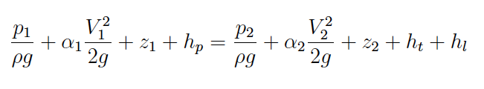
Energy Equation
The energy equation relates the total dynamic head at two points in a system, accounting for frictional losses and any added head from a pump.
h_{p} =
head supplied by a pump
h_{t} =
head recovered by a turbine
h_{L} =
head lost to friction

Slide 9
Energy Equation application Assumptions
Pressure is hydrostatic in both cross sections
Fluid is incompressible
Density is constant at the cross section
Flow is steady

Slide 10
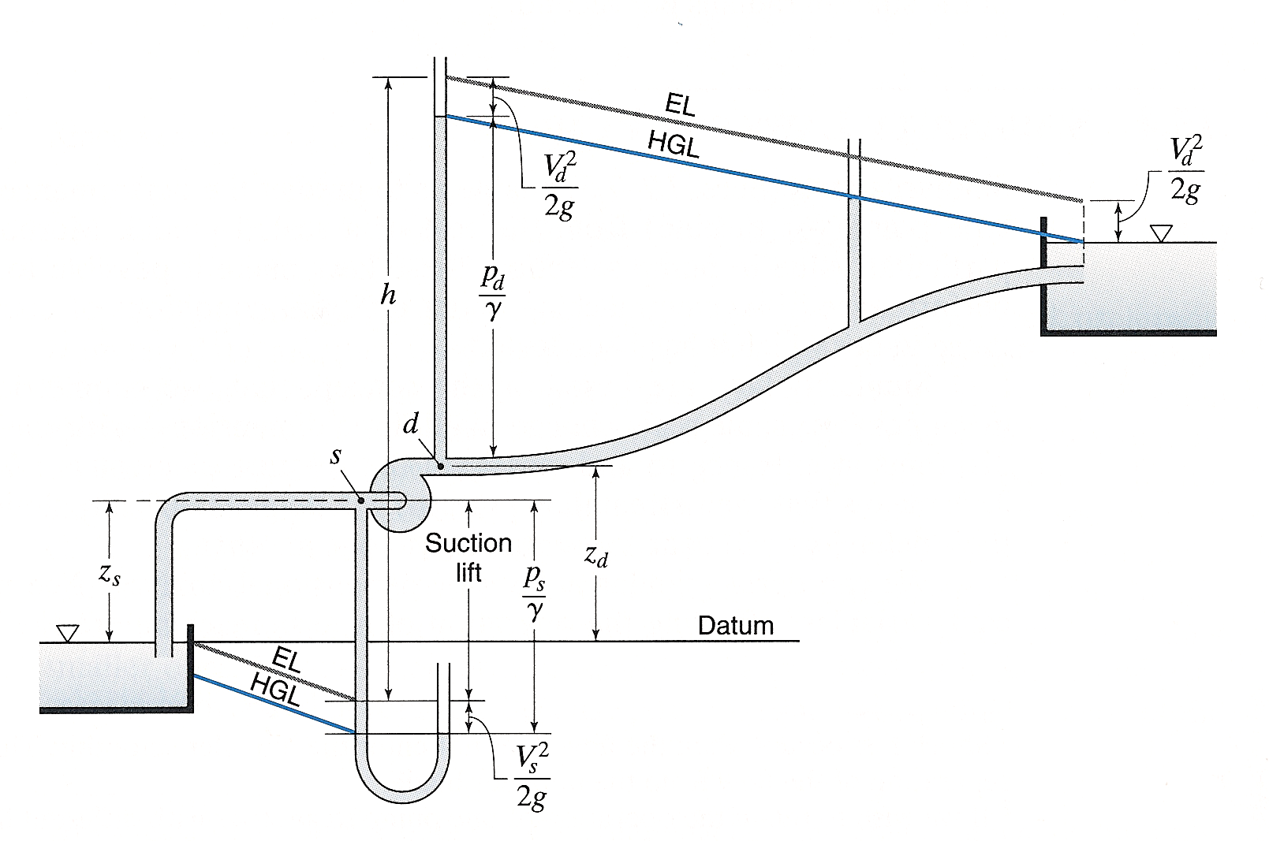
Diagram
Notes:
S is suction, d is distribution side
Pressure usually cancels out because both reservoirs are at atmospheric pressure
If cross sectional area remains the same at 2 points, velocity head can be neglected
NOTE: EGL and HGL remain same distance apart
IF XS area changes, velocity head changes across the pipe
Elevation is based on datum to the point

Slide 11
Energy Equation
2
1

Slide 12
Hydraulic grade line
HGL is a line that represents the surface/profile of water flowing in partially full pipe
If pipe is under pressure, flowing full the HGL rises to where a free surface would exist if there were a piezometer installed in the pipeline

Slide 13
Energy grade line
EGL is a line that represents the elevation of energy head of water flowing in a conduit
It is the sum of the elevation, pressure, and velocity head at a location
Drawn above HGL at a distance equal to the velocity head

Slide 14
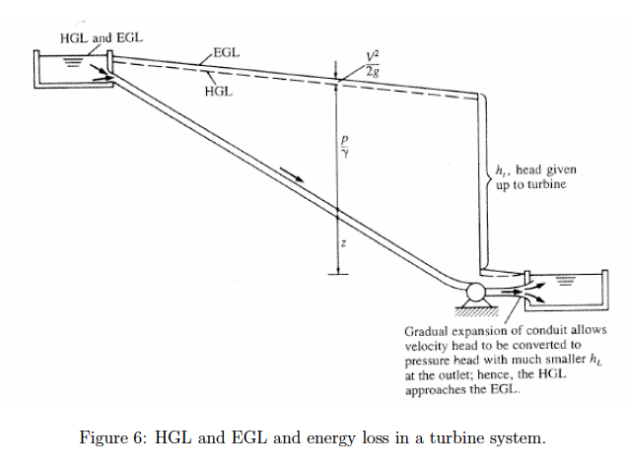
HGL/EGL

Slide 15
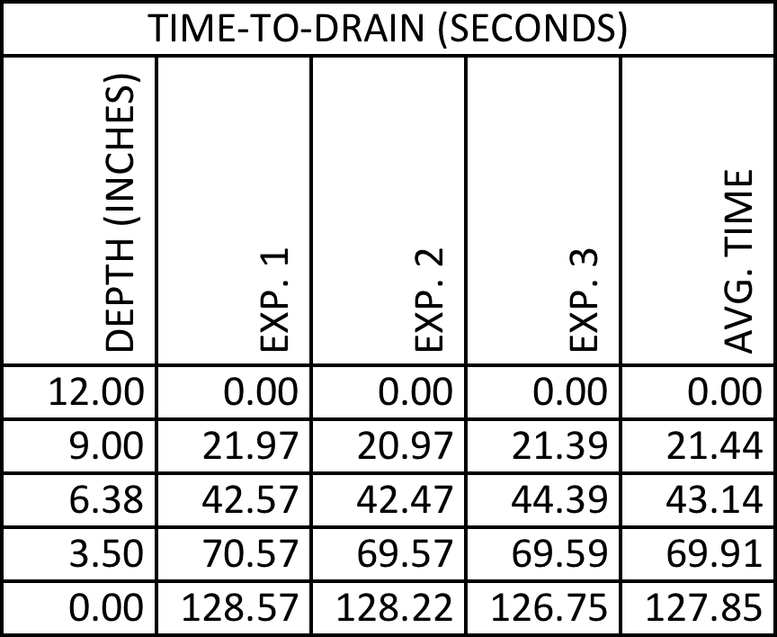
example
Analyze an ordinary bucket (diameter = 1 foot) with a ½-inch hole drilled at the base of the bucket.
Develop an equation that estimates time-to-drain for different fill depths (with an unknown drainage coefficient)
Compare to observed data to infer a drainage coefficient

Slide 16
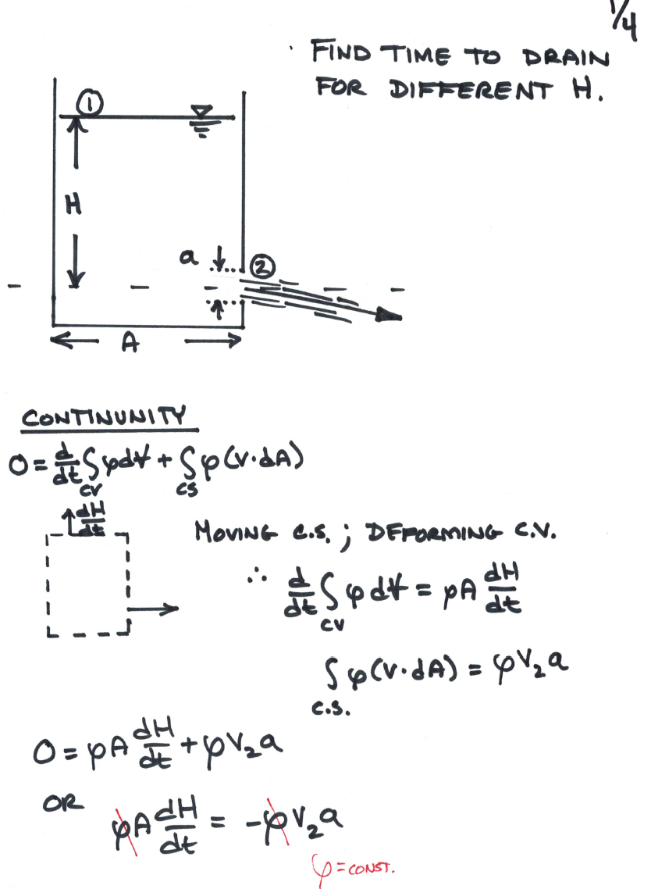
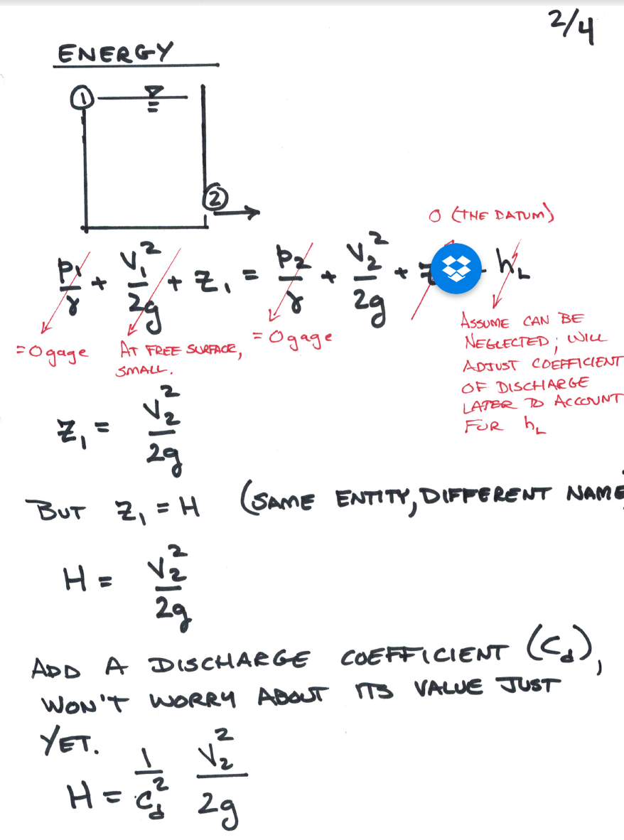
ANALYSIS

Slide 17
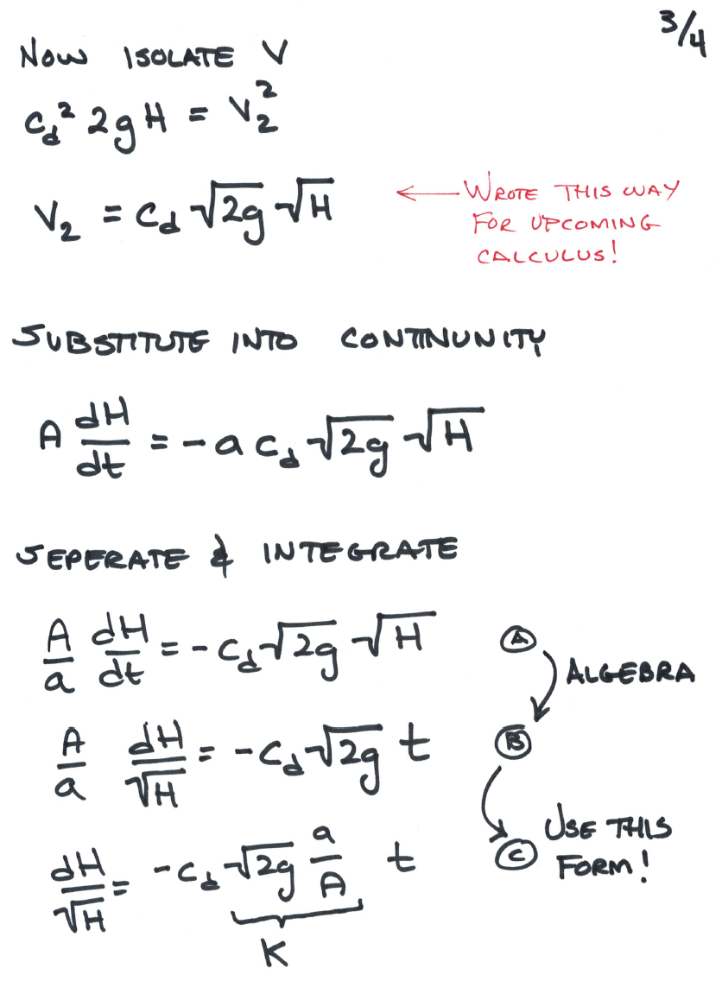
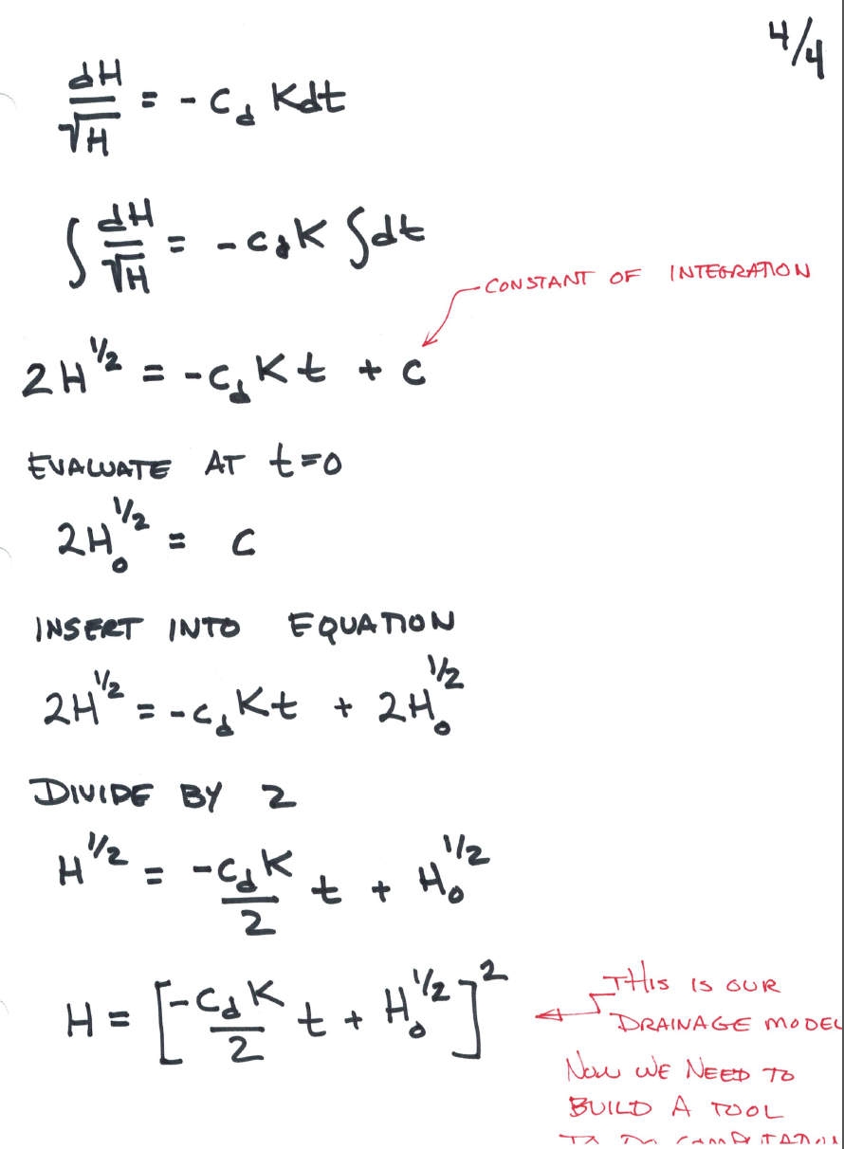
ANALYSIS

Slide 18
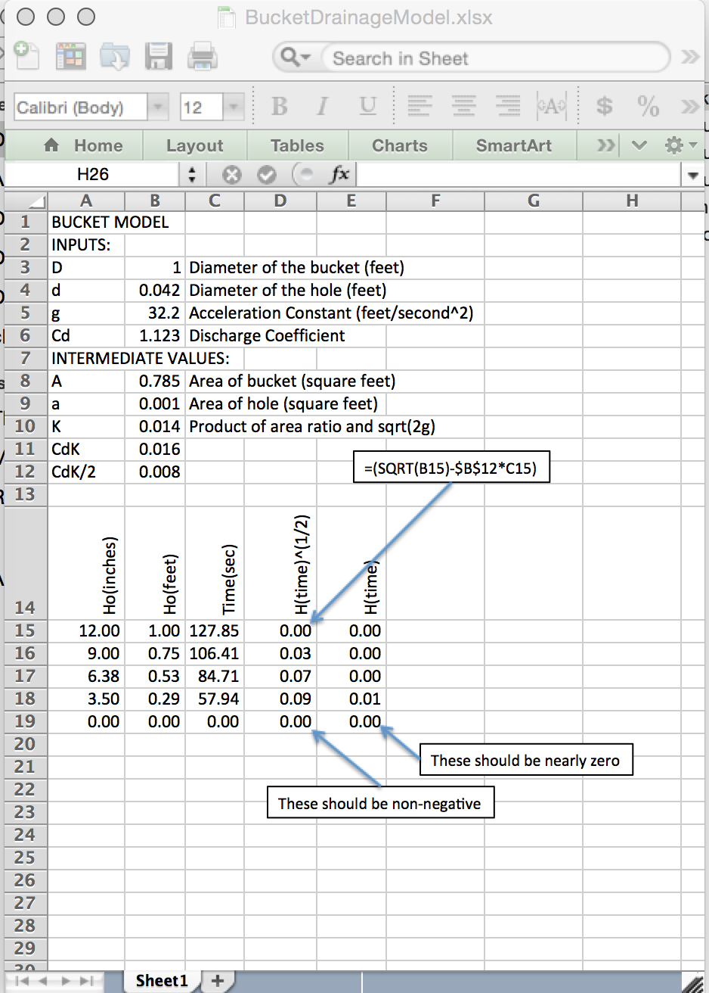
RESULT

Slide 19
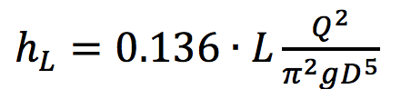
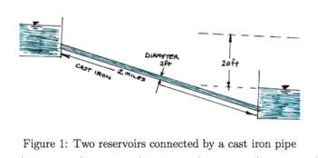
example
Estimate discharge between two reservoirs
Head Loss is given as
Notes:
Do analysis in class – build tool in class. Direct application of energy equation.

Slide 20
HEAD LOSS MODELS
Head Loss Models (for losses in pipes)
Darcy-Weisbach
Moody Chart
Examples
Jain Equations
Hazen-Williams
Chezy-Manning
Fitting (Minor) Losses

Slide 21
Pipeline system
2
1
Head Loss Model
Pump Curve

Slide 22
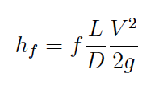
Darcy-Weisbach loss model for pipe loss
Frictional loss proportional to
Length, Velocity^2
Inversely proportional to
Cross sectional area
Loss coefficient (f) depends on
Reynolds number (fluid and flow properties)
Roughness height (pipe material properties)

Slide 23
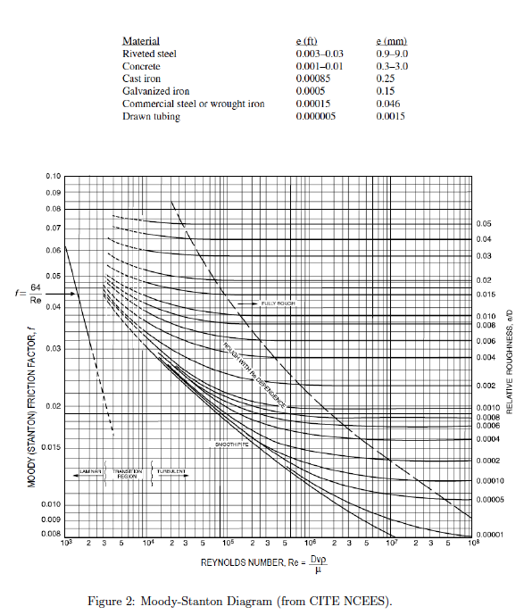
Moody Chart
Moody-Stanton chart is a tool to estimate the friction factor in the DW head loss model
Used for the pipe loss component of friction

Slide 24
Examples
Three “classical” examples using Moody Chart
Head loss for given discharge, diameter, material
Discharge given head loss, diameter, material
Diameter given discharge, head loss, material

Slide 25
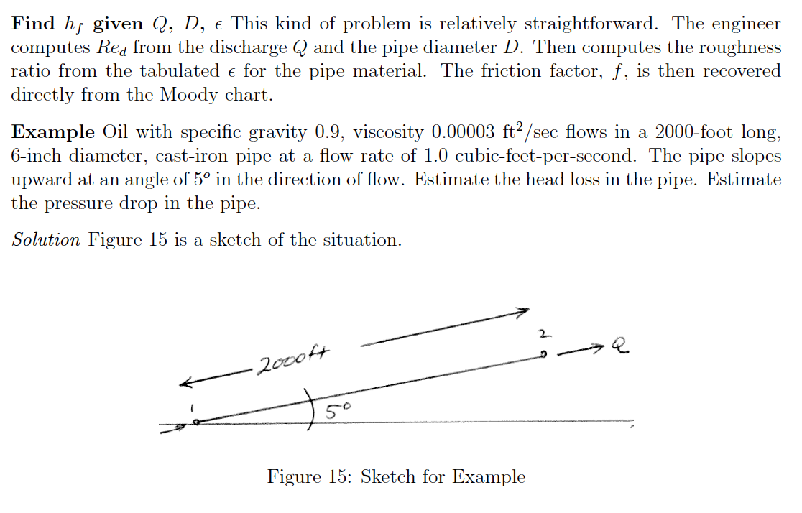
Example 1
Head loss for given discharge, diameter, material

Slide 26
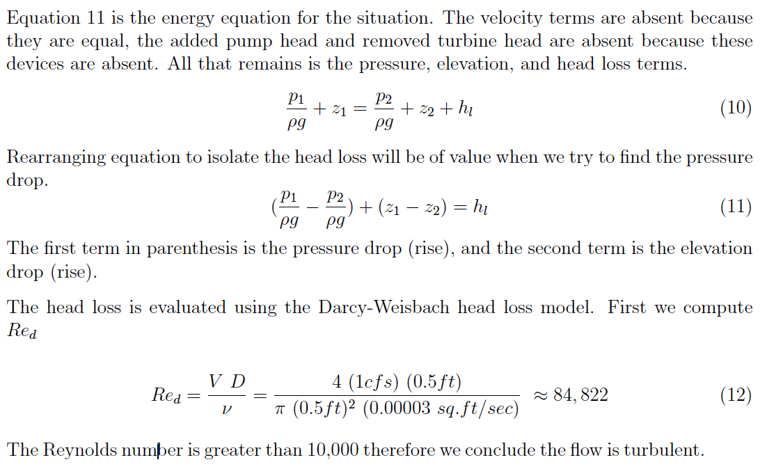
Example 1
Head loss for given discharge, diameter, material

Slide 27
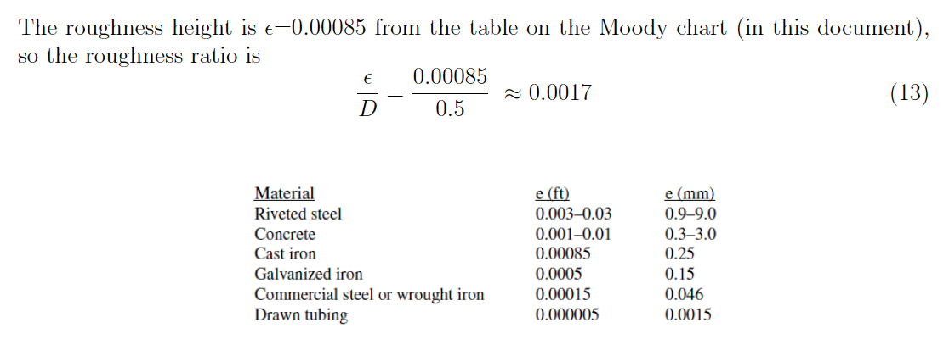
Example 1
Head loss for given discharge, diameter, material

Slide 28
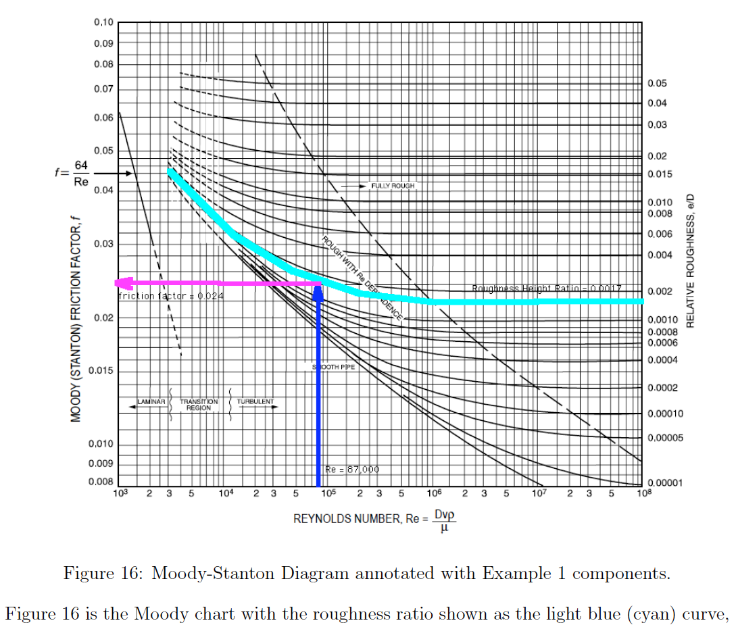
Example 1
Head loss for given discharge, diameter, material

Slide 29
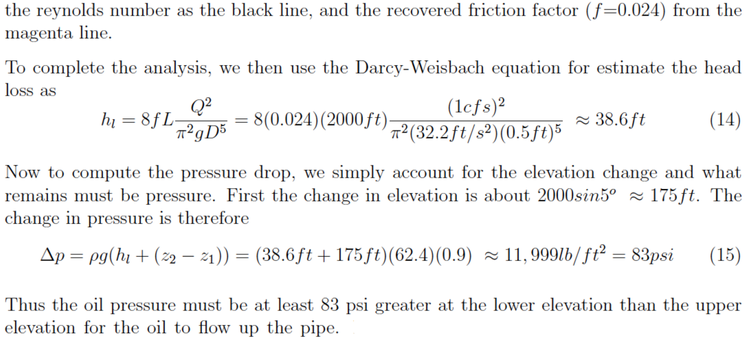
Example 1
Head loss for given discharge, diameter, material

Slide 30
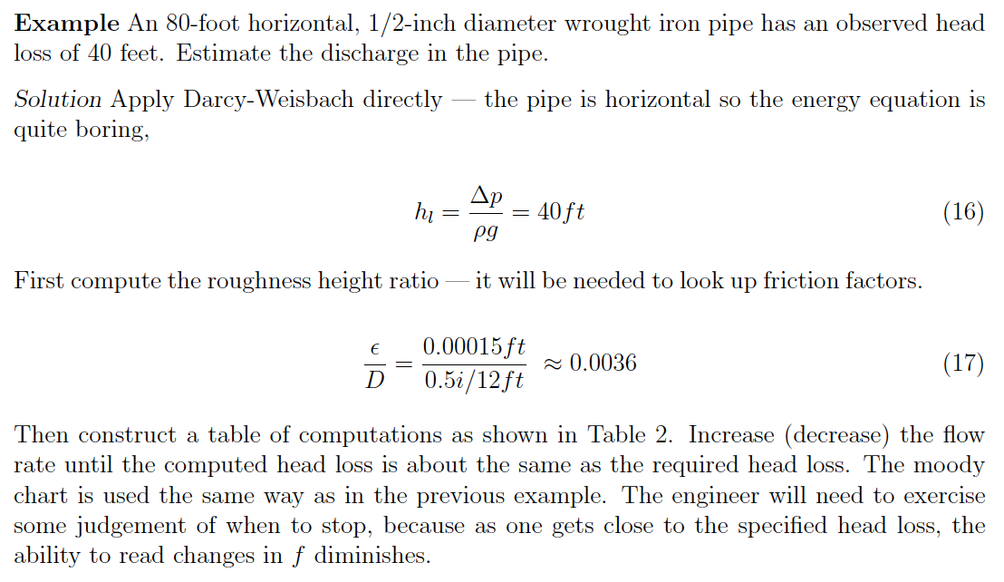
Example 2
Discharge given head loss, diameter, material

Slide 31
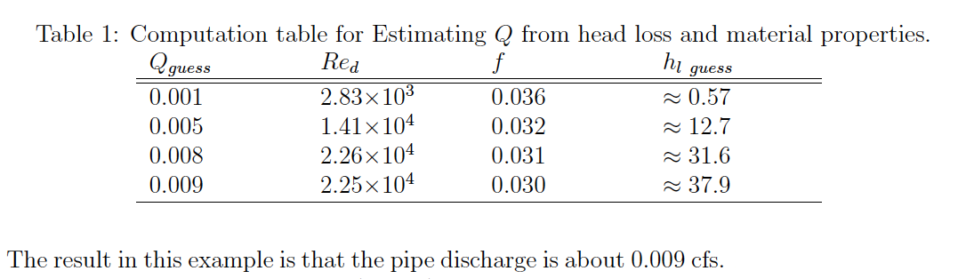
Example 2
Discharge given head loss, diameter, material

Slide 32
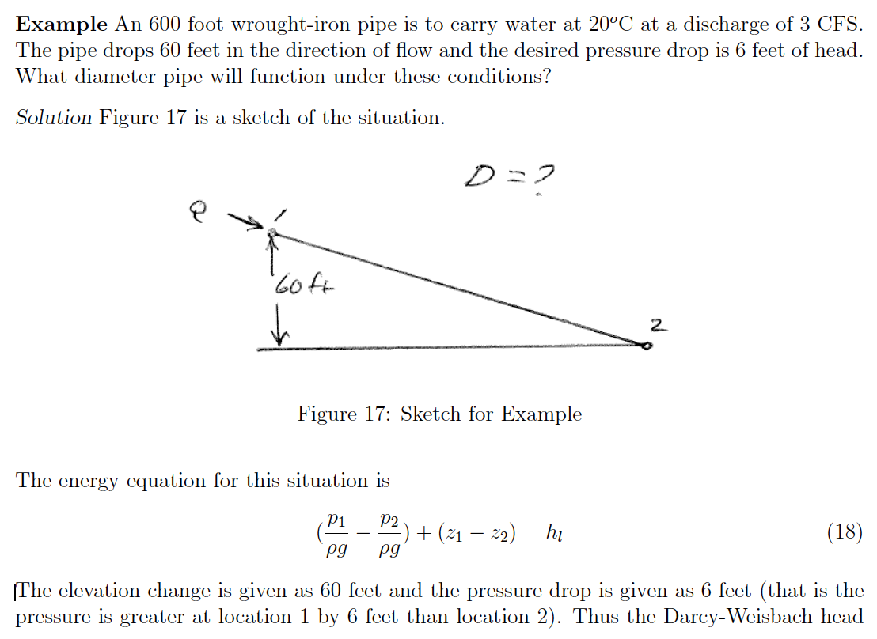
Example 3
Diameter given discharge, head loss, material

Slide 33
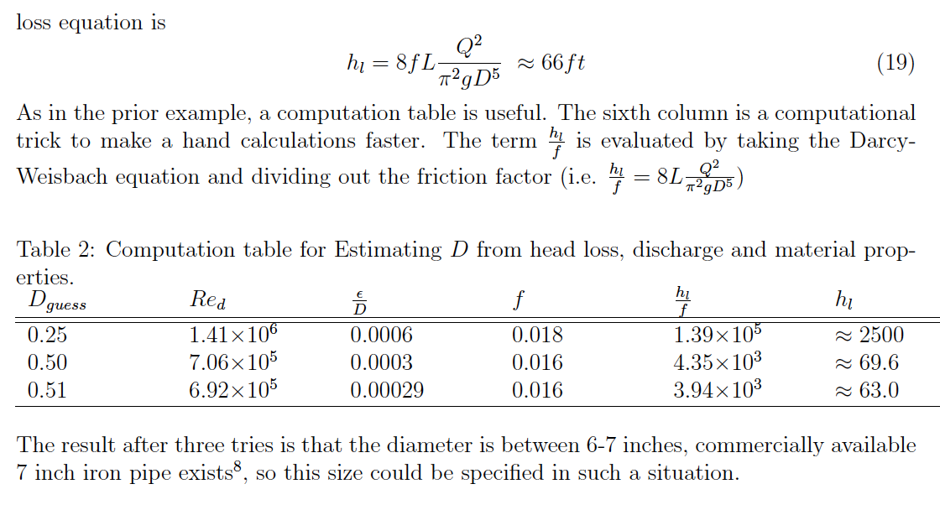
Example 3
Diameter given discharge, head loss, material

Slide 34
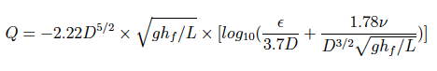
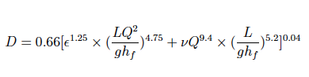
Direct (Jain) Equations
An alternative to the Moody chart are regression equations that allow direct computation of discharge, diameter, or friction factor.

Slide 35
Jain equations
Example – Build a VBA Tool
State the programming problem
Known (Inputs)
Unknown (Outputs)
Governing Equation(s)
Test the tool

Slide 36
Jain equations
State the programming problem:
Write a function that takes inputs for the Jain equation and produces an estimate of discharge
Write an interface (spreadsheet) that accepts the inputs, calls the function, and returns the computed discharge

Slide 37
Jain equations
Known (inputs)
Engineer will specify (known):
Diameter, D; Length of pipe, L; Roughness height, ε;
Viscosity, ν; Gravitational acceleration constant, g;
Slope of the EGL (hf/L)

Slide 38
Jain equations
Unknown (outputs)
Function will compute:
Discharge, Q.

Slide 39
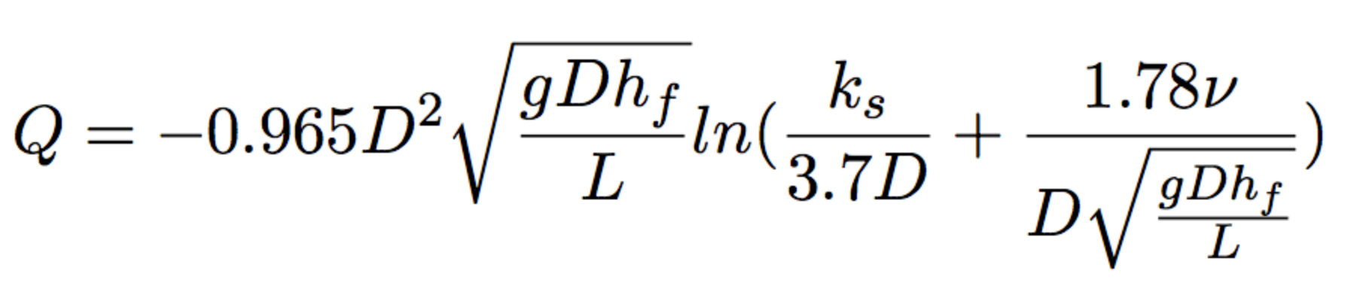
Jain equations
Governing Equation(s)
(k_{s} and ε are the same critters!)
The Jain Equation (above) is the governing equation; however if we do some algebra to move D^2 into the square root terms and the natural logarithm we can compact the arithmetic used in computation slightly – the result is shown (below)

Slide 40
Jain equations
Build and Test the tool
Going to build in Excel VBA
Provides a way to create a function that we can re-use; will find the concept handy when we build a by-hand network simulator

Slide 41
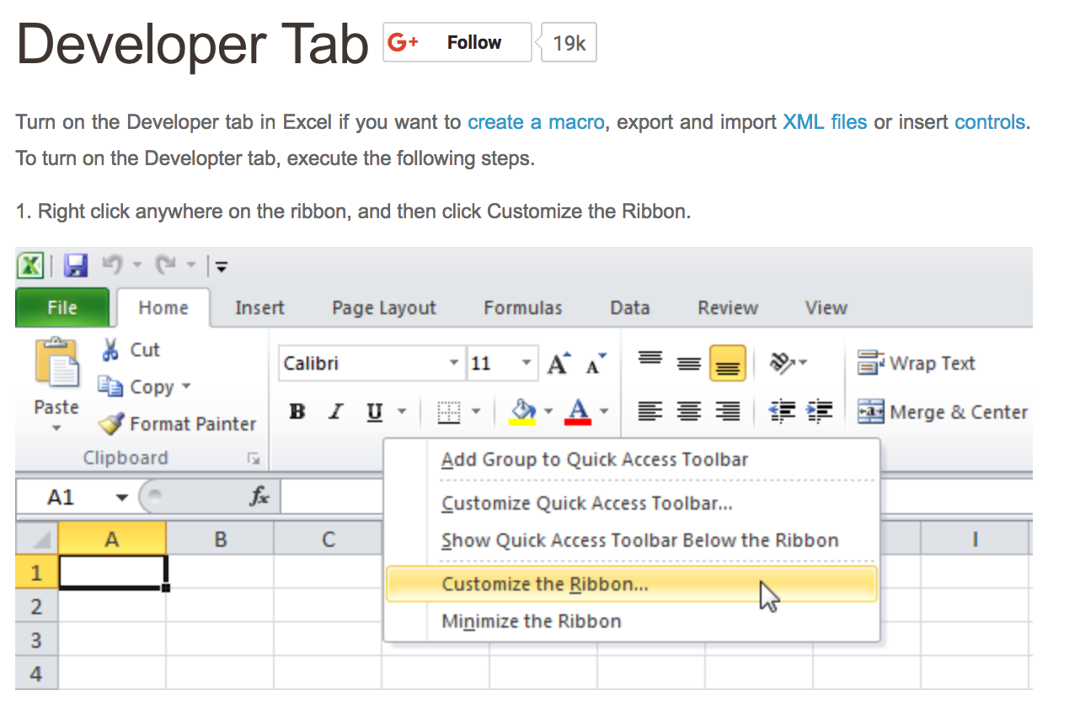
Jain equations
Build and Test the tool
To program in VBA we need to activate the developer environment. (Windows)

Slide 42
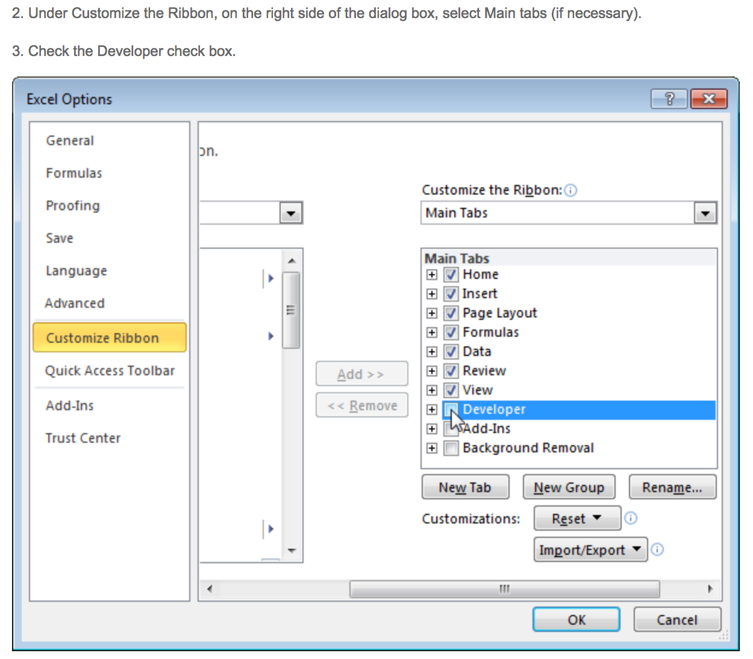
Jain equations
Build and Test the tool
To program in VBA we need to activate the developer environment. (Windows)

Slide 43

Jain equations
Build and Test the tool
To program in VBA we need to activate the developer environment. (Windows)

Slide 44
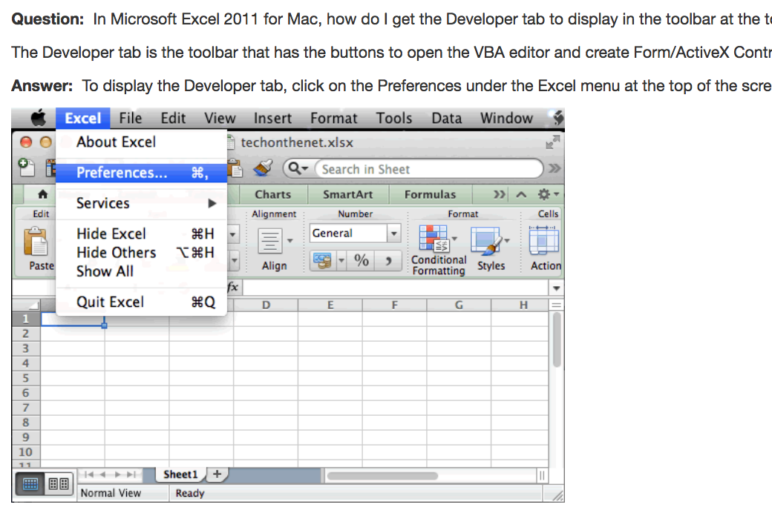
Jain equations
Build and Test the tool
To program in VBA we need to activate the developer environment. (mac_OS)

Slide 45

Jain equations
Build and Test the tool
To program in VBA we need to activate the developer environment. (Mac_OS)

Slide 46
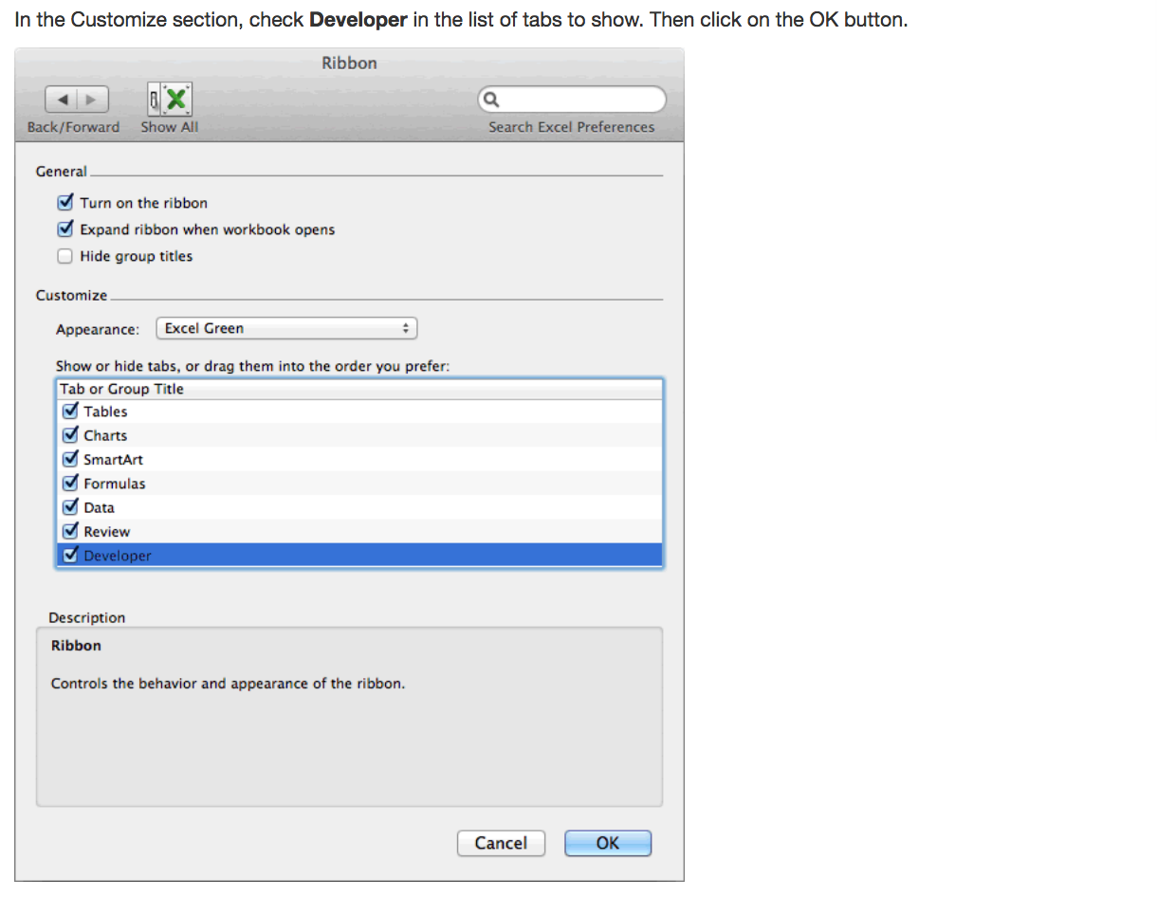
Jain equations
Build and Test the tool
To program in VBA we need to activate the developer environment. (Mac_OS)

Slide 47
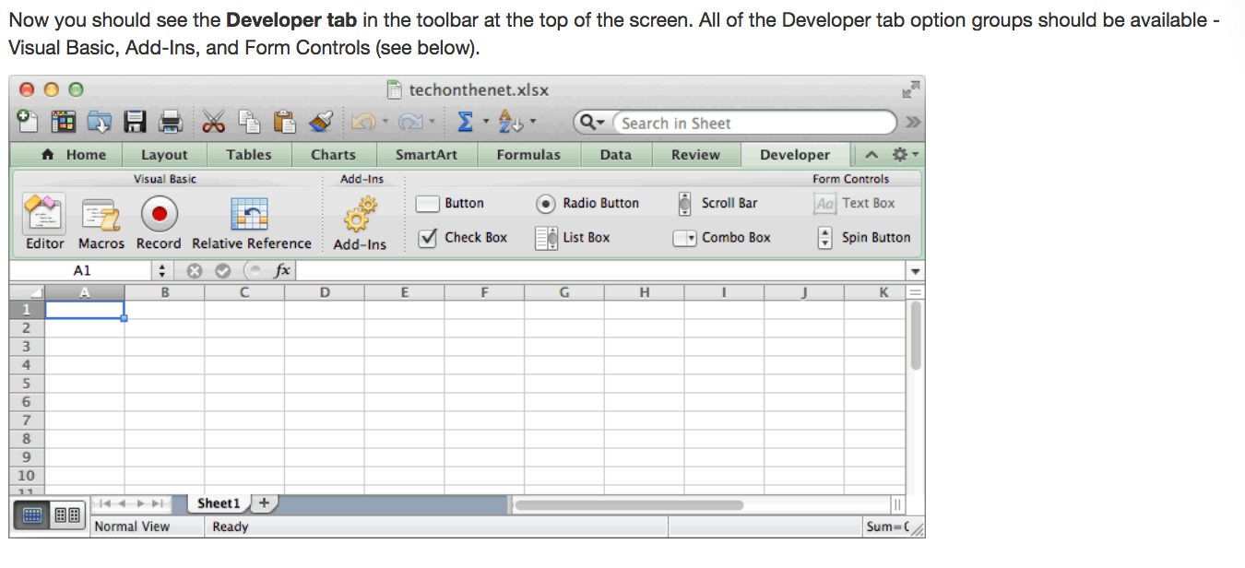
Jain equations
Build and Test the tool
To program in VBA we need to activate the developer environment. (Mac_OS)

Slide 48
Jain equations
Build and Test the tool
Once the developer tab is available the coding of the spreadsheet is pretty similar in either architecture.
We will then open the editor in developer
Then choose “add module” – the module is where we can directly enter programs

Slide 49
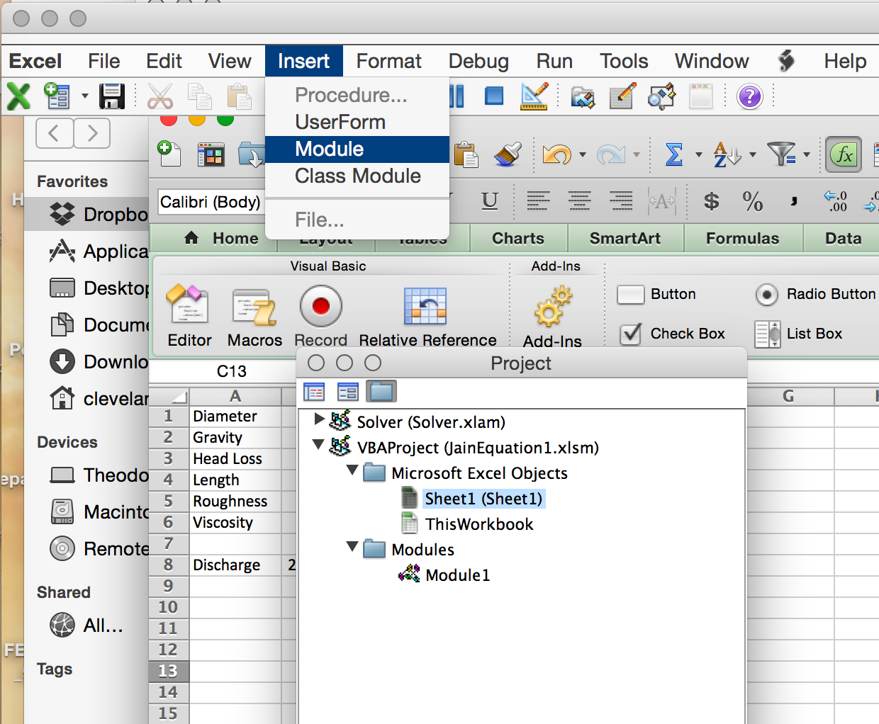
Jain equations
Build and Test the tool
Here we “Insert a Module” – In my case it is called Module 1. it is local to the worksheet

Slide 50
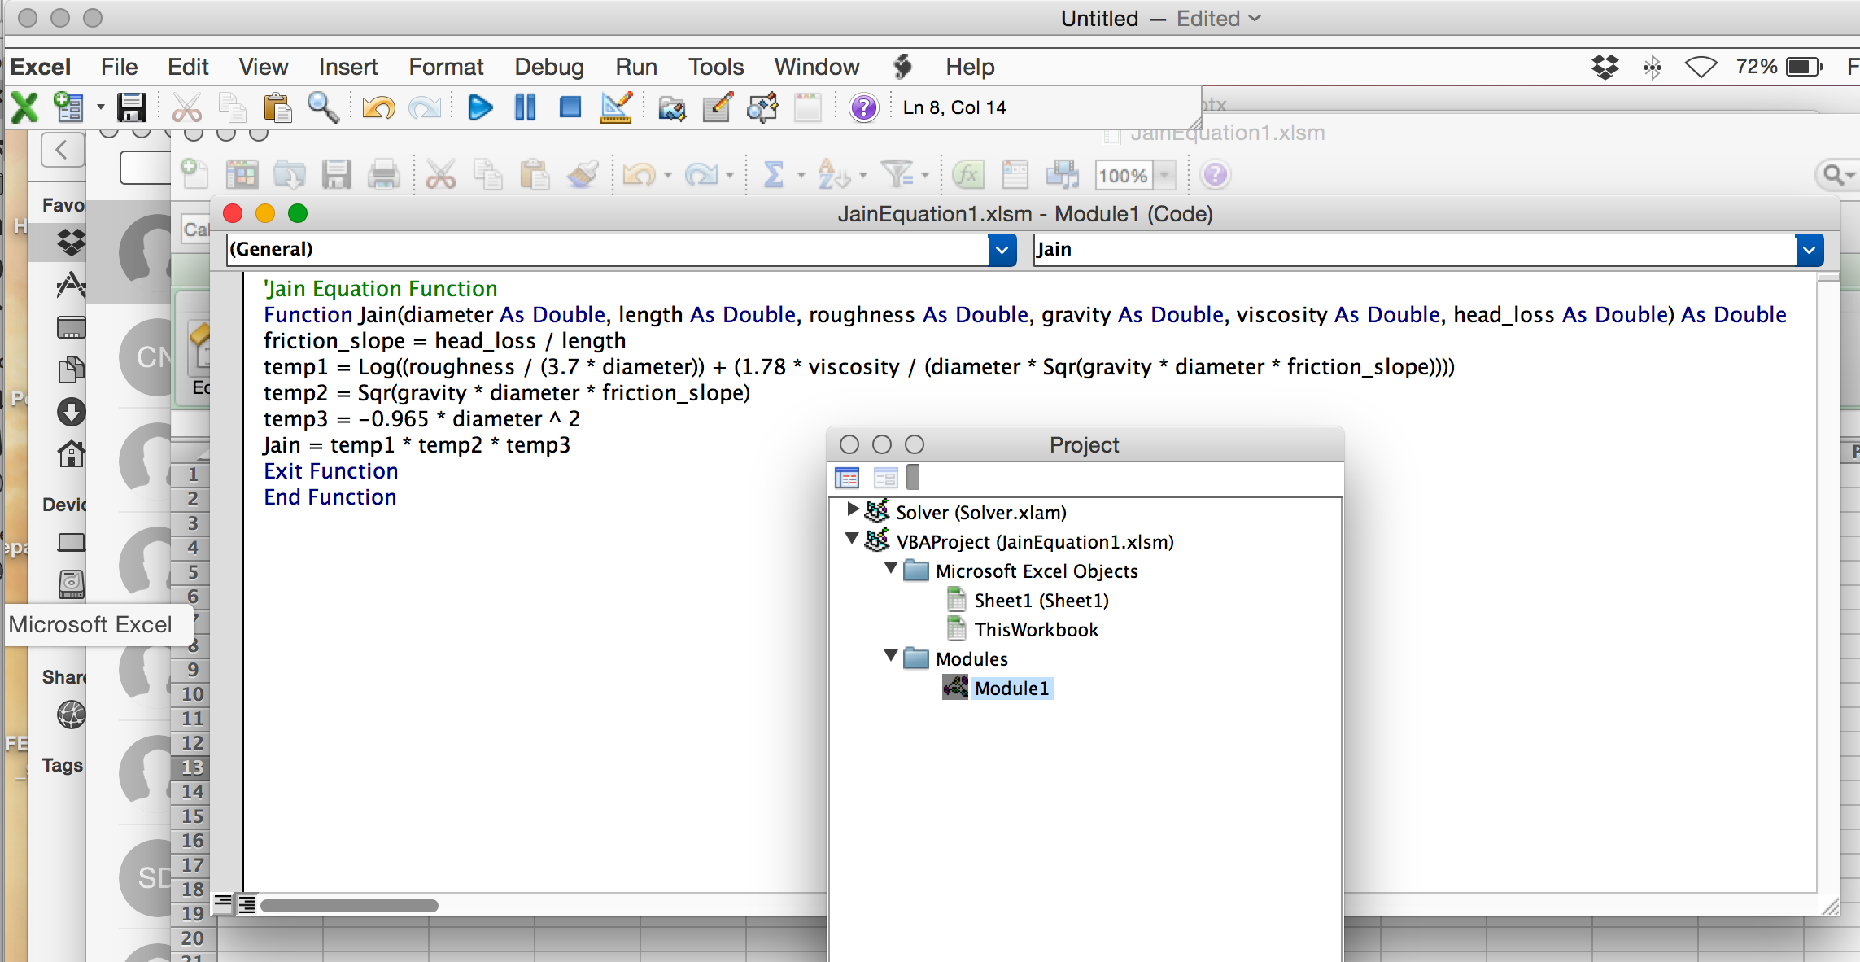
Jain equations
Build and Test the tool
Next we select the module and type in the required code

Slide 51
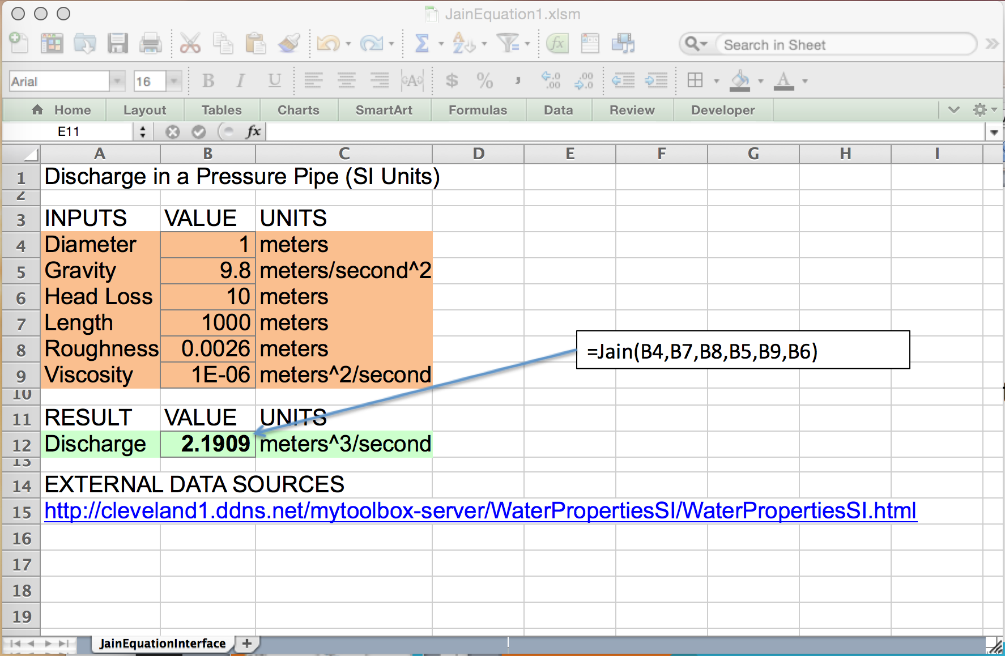
Jain equations
Build and Test the tool
With code built, now need an interface – that’s a normal spreadsheet looking thing
Includes a link to a fluid properties database

Slide 52
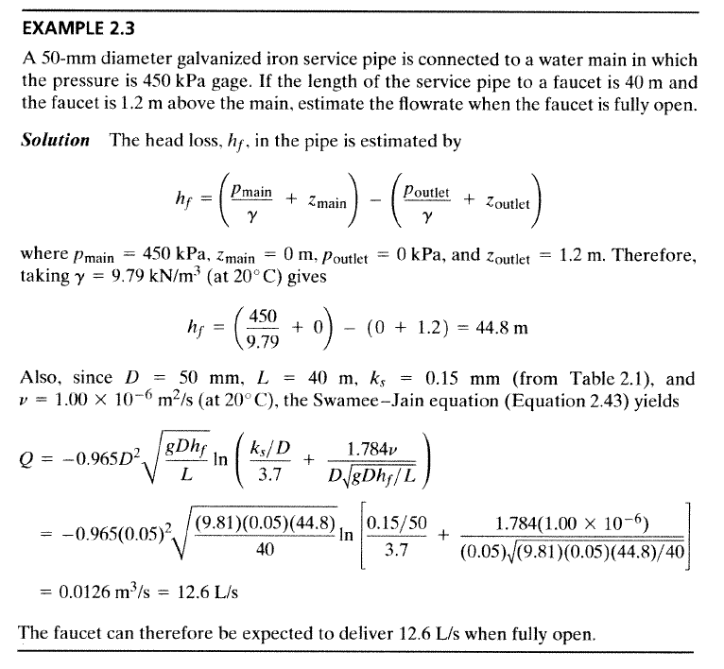
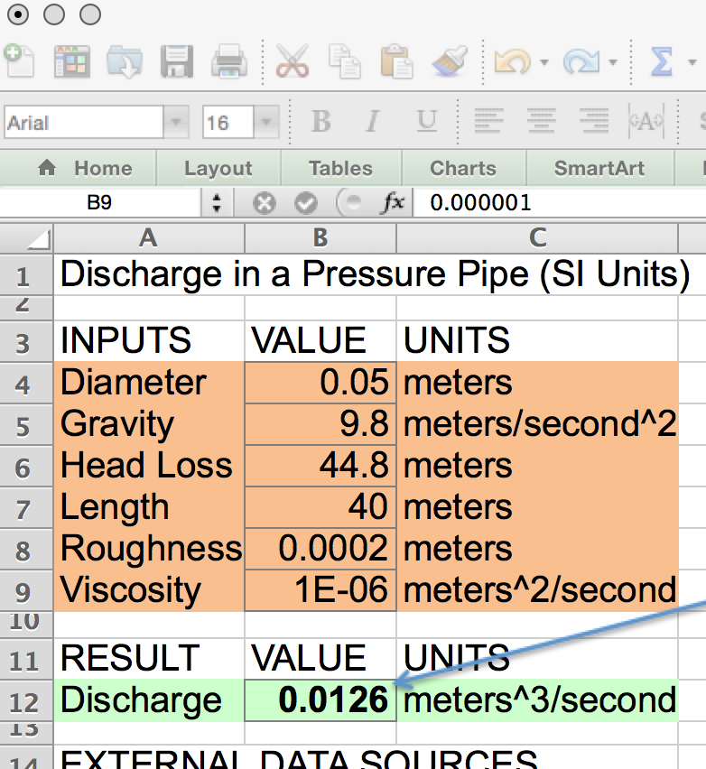
Jain equations
Build and Test the tool
Now need to test the tool using known solutions:

Slide 53
Jain equations
Link to On-Line Tool
A similar tool (to the spreadsheet just developed) is available online at:
http://theodores-pro.ttu.edu/mytoolbox-server/Hydraulics/QGivenHeadLoss/QGivenHeadLoss.html

Slide 54
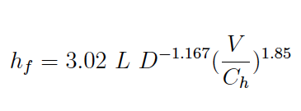
Hazen-Williams
Frictional loss proportional to
Length, Velocity^(1.8)
Inversely proportional to
Cross section area (as hydraulic radius)
Loss coefficient (Ch) depends on
Pipe material and finish
Turbulent flow only (Re>4000)
WATER ONLY!

Slide 55
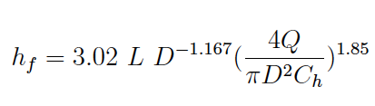
Hazen-Williams
HW Head Loss
Discharge Form

Slide 56
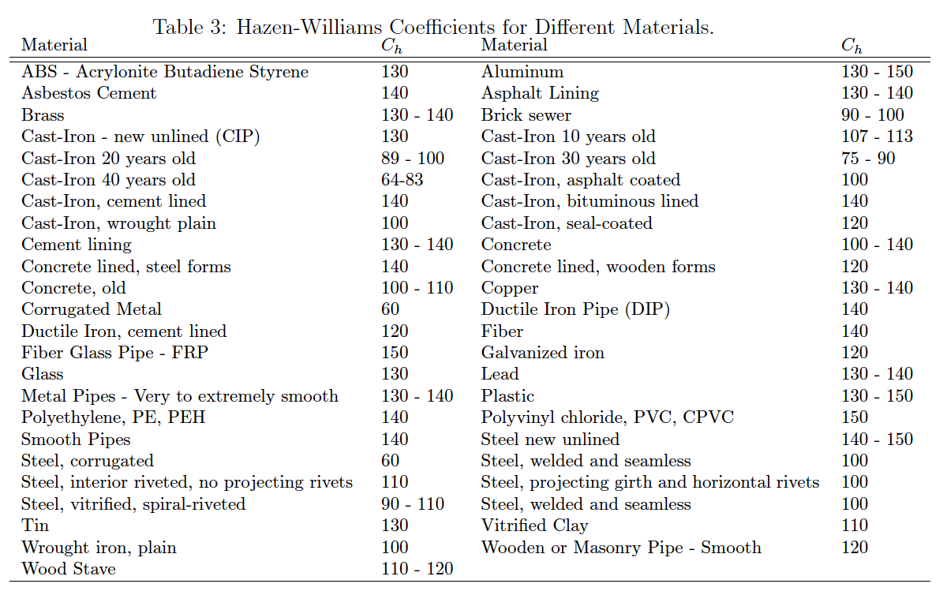
Hazen-williams
Hazen-Williams C-factor

Slide 57
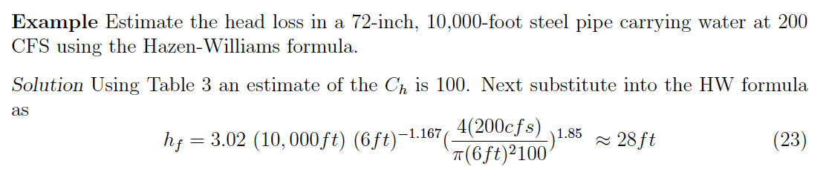
Example using hazen-williams formula

Slide 58
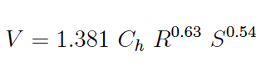
Hydraulic Radius
HW is often presented as a velocity equation using the hydraulic radius

Slide 59
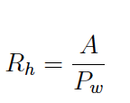
Hydraulic Radius
The hydraulic radius is the ratio of cross section flow area to wetted perimeter

Slide 60
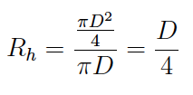
Hydraulic Radius
For circular pipe, full flow (no free surface)
AREA
PERIMETER
D

Slide 61
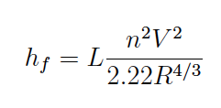
Chezy-Manning
Frictional loss proportional to
Length, Velocity^2
Inversely proportional to
Cross section area (as hydraulic radius)
Loss coefficient depends on
Material, finish

Slide 62
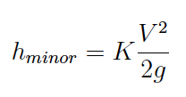
Fitting (Minor) Losses
Fittings, joints, elbows, inlets, outlets cause additional head loss.
Called “minor” loss not because of magnitude, but because they occur over short distances.
Typical loss model is

Slide 63
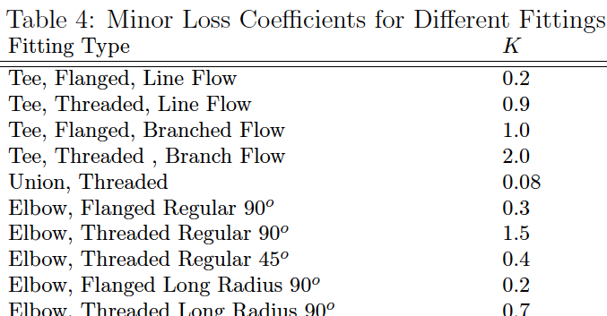
Fitting (Minor) Losses
The loss coefficients are tabulated for different kinds of fittings

Slide 64
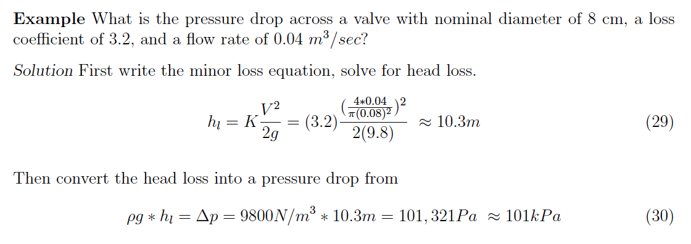
Example – fitting (minor) losses

Slide 65
Pipeline system
Length_2
Length_1
2
=Length_1 + Length_2
Elbow
Exit
1
Inlet
Head Loss Model
Pump Curve

Slide 66
NEXT TIME
Pumps in hydraulic systems
Pump curves
System curves
Power requirements

